Slide 1
Final Engagement
Attack, Defense & Analysis of a Vulnerable Network

Slide 2
Table of Contents
This document contains the following resources:
Network Topology & Critical Vulnerabilities
Exploits Used
Methods Used to Avoiding Detect

Slide 3

Network Topology
& Critical Vulnerabilities
3

Slide 4
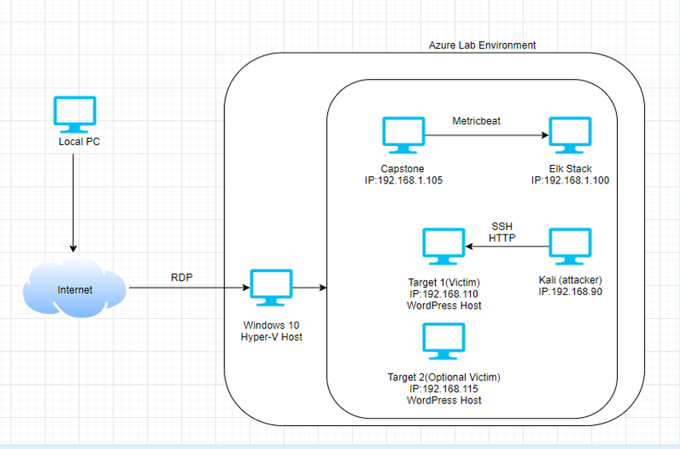
Network Topology
Network
Address Range: 192.168.1.0/24
Netmask: 255.255.255.0
Gateway: 192.168.1.1
Machines
IPv4: 192.168.100
OS: Linux
Hostname: ELK
IPv4: 192.168.1.105
OS: Linux
Hostname: Capstone
IPv4: 192.168.1.110
OS: Linux
Hostname: Target 1
IPv4: 192.168.1.115
OS: Linux
Hostname: Target 2
IPv4: 192.168.1.90
OS: Linux 2.6.32
Hostname: Kali
[Insert Here]
Use draw.io to create a diagram of the network.
Add your diagram to this slide and fill out the data in the sidebar.

Slide 5
Critical Vulnerabilities: Target 1
Our assessment uncovered the following critical vulnerabilities in Target 1.
Vulnerability | Description | Impact
Weak Password Policy | Having weal passwords that can be brute forced easily by mere guessing is not good. | User Michael’s password was ‘michael’. Also, it allowed users to keep the same password for a long period, makes brute force more successful.
Port 80 | The port that allows web traffic (HTTP) into server | Port 80 is vital to open any webserver but needs to be secured properly.
Security Misconfiguration | Misconfiguration of unprotected files/directories, default credentials. | Allowing unprivileged user access to files they shouldn’t have access. For eg. “wp-config.php” could be very dangerous if wrong person accessed it.
WordPress Enumeration | Performed wpscan enumeration | This exposes the critical information like authorised list of WordPress users and an attacker can further brute force that user's credentials.

Slide 6
Critical Vulnerabilities: Target 2
Our assessment uncovered the following critical vulnerabilities in Target 2.
Vulnerability | Description | Impact
HTTP Query Modification | Inserting additional commands into the HTML query to gain additional information. | By adding extra wordings at the end of web address, the website takes to pages that might be confidential.
Path Traversal Attack | Allows navigation to pages that normal users are not intended to visit and interact with | Having access to restricted webpages could be a major security flaw.

Slide 7
Exploits Used
7

Slide 8
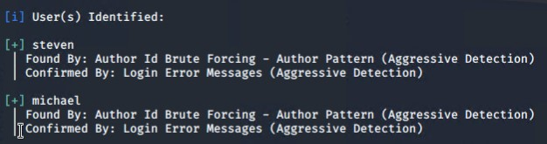
Exploitation: WordPress Enumeration
WPScan using ‘-- url http://192.168.1.110/wordpress -e u’ the program scanned for user login accounts
This exploit gave access to usernames “Michael” and “Steven”

Slide 9
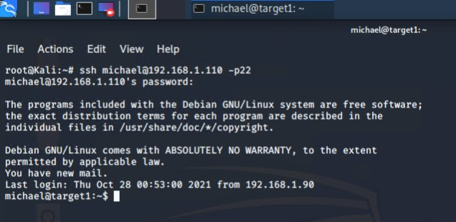
Exploitation: Weak Password Policy
Simply by guessing Michael’s password was easy enough, though a tool such as ‘hydra’ would have easily cracked the password in no time, unfortunately this would be much easier to detect.
This allowed us to gain access to Michael's account on the target machine (192.168.1.110)

Slide 10
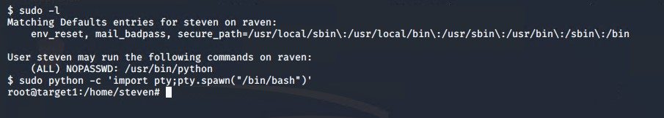
Exploitation: Privilege Escalation
After gaining Steven’s credentials through MySQL, we were able gain access to his account. Looking into Steven’s privileges we saw that he is able run python commands with no password.
Using this python exploit we were able to gain root access and find flag 4.

Slide 11
Avoiding Detection
11

Slide 12
Stealth Exploitation of Scanning Open Ports of Target (nmap)
Monitoring Overview
The alert “HTTP Request Size Monitor” was triggered.
This measures the amount of requests received by the target.
The threshold for this is 3500 requests per minute.
Mitigating Detection
Setting the Timing Template (-T) and -sS options using nmap.
While there are many comparable alternatives, nmap is the best choice unless scanning a machine with very strict alerts with low thresholds.

Slide 13

Stealth Exploitation of Directory Enumeration
Monitoring Overview
The alerts “Excessive HTTP Errors” and “HTTP Request Size Monitor” were triggered.
“Excessive HTTP Errors” measures the amount of returned HTTP response codes for the top 5 most returned codes over 5 mins. “HTTP Request Size Monitor” measure the number of requests sent to the target per minute.
“Excessive HTTP Errors” fires at 400 response codes every 5 mins and “HTTP Request Size Monitor” fires at 3500 requests per minute.
Mitigating Detection
Setting a delay between each tested directory/file and using a smaller wordlist.
An alternative would be to guess the directory paths in a browser. However, this is less aggressive, it is more time consuming too.

Slide 14
Stealth Exploitation of WordPress User Enumeration (wpscan)
Monitoring Overview
Excessive HTTP Errors” alert would detect this.
This measures the amount of returned HTTP response codes for the top 5 most returned codes.
400 is the threshold for this alert
Mitigating Detection
Using a less aggressive setting for the enumeration (less packets over time).
Manual enumeration using author query in URL.

